Slide 1
Cloud Computing
BICTE

Slide 2
Introduction
Ashok Bhattarai
Cloud Computing Instructor
BE Computer | Masters in Computer Science
Senior Software Engineer, Cedar Gate Technologies
LinkedIn: linkedin.com/in/ashokbhattarai

Slide 3
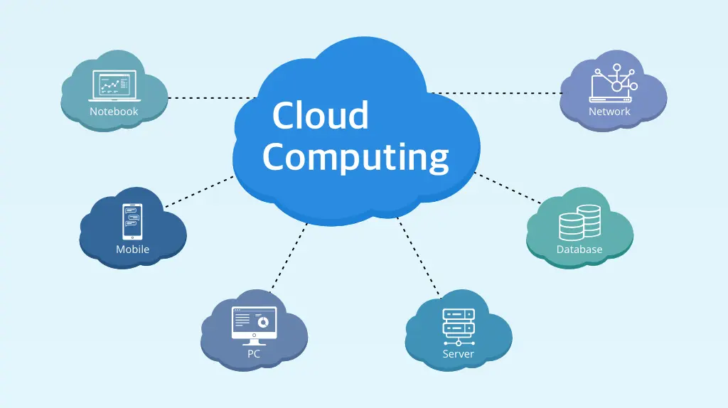
What is Cloud Computing?

Slide 4
What is Cloud Computing?
Cloud Computing means using someone else’s computer over the internet.

Slide 5
What is Cloud Computing?
• Delivery of computing services over the internet
• Includes servers, storage, databases, networking
• Pay-as-you-go model
• Enables flexibility, scalability, and cost savings

Slide 6
Why Learn Cloud Computing?
🚀 High Demand & Career Growth
Cloud skills are among the top requirements globally, opening doors to high-paying IT jobs.
☁️ Future of Technology
Most companies are migrating to the cloud—banks, startups, hospitals, governments.
⚡ Build & Deploy Faster
Create servers, databases, and apps in minutes.
💰 Cost Efficient
Organizations save huge amounts by switching from physical data centers.
🔒 Secure & Reliable
Cloud provides industry-grade security, backups, and disaster recovery.
🌍 Learn With Free Resources
AWS, Azure, and GCP all provide free tiers suitable for students.

Slide 7
Examples of Cloud Services
• Google Drive, Gmail
• Microsoft Azure & Office 365
• Amazon Web Services (AWS)
• Zoom, YouTube, Facebook

Slide 8
Types of Cloud Models
• Public Cloud
• Private Cloud
• Hybrid Cloud
• Community Cloud

Slide 9
Examples of Cloud Models
🌐 Public Cloud (Example: AWS, Azure, GCP)
Services shared over the internet
Example: Hosting a website on AWS EC2
🏢 Private Cloud (Example: OpenStack, VMware)
Dedicated infrastructure for one organization
Example: A bank running its secure applications on its own private cloud
🔄 Hybrid Cloud (Example: AWS Outposts, Azure Stack)
Combination of public + private cloud
Example: Company stores sensitive data privately but uses public cloud for apps
👥 Community Cloud
Shared by specific communities or organizations
Example: Universities sharing a cloud for research collaboration

Slide 10
Service Models
• Infrastructure as a Service (IaaS)
→ You rent a kitchen, buy raw materials, you cook yourself
• Platform as a Service (PaaS)
→ They give you the kitchen + gas + utensils; just cook
• Software as a Service (SaaS)
→ You order ready-made momo and eat

Slide 11
IaaS
Pay for what you use
Avoid purchasing hardware and software
Ability to scale
You get virtual machines, storage, network.
Cloud gives hardware; you manage OS, apps, data.
Examples:
Amazon EC2 (Virtual servers)
Microsoft Azure VM
Google Compute Engine
DigitalOcean Droplets
AWS S3 (Storage Service)
“IaaS = Renting a computer in the cloud.”

Slide 12
PaaS
You get runtime environment, OS, database, middleware.
You deploy code; platform handles everything else.
Examples:
AWS Elastic Beanstalk
Google App Engine
Heroku
Microsoft Azure App Service
Firebase
OpenShift
Easy way to remember:
👉 “PaaS = You bring the code. Cloud runs it.”

Slide 13
SaaS
You get a ready-made application running on the internet.
Just use the software — no setup needed.
Examples:
Gmail
Microsoft 365 / Office 365
Google Workspace
Zoom
Salesforce
Slack
Dropbox
Easy way to remember:
👉 “SaaS = Use the software directly.”

Slide 14
Basic Cloud Terms
Compute → Server
Storage → Hard disk on cloud
Database → Data management
Networking → Internet connection
Scalability → Auto increase capacity
High Availability → Always on

Slide 15
Risk and Challenges
🔒 1. Security & Privacy Concerns
Data breaches and unauthorized access
Misconfigured cloud resources
🌐 2. Downtime & Service Outages
Cloud provider outages can disrupt services
Dependency on internet connectivity
💰 3. Cost Management Issues
Unexpected costs due to improper monitoring
Pay-as-you-go model can increase cost if not optimized

Slide 16
Risk and Challenges
🔄 4. Vendor Lock-In
Difficult to switch providers once fully integrated
Differences in tools, APIs, and architectures
🛠️ 5. Limited Control
Hardware, infrastructure, and some configurations are controlled by the provider
📜 6. Compliance & Legal Issues
Challenges in meeting data residency and regulatory requirements

Slide 17
Today's Class Overview
• Course introduction
• What we will study in Cloud Computing
• Expectations and outcomes
• Q&A

